Slide 1
Logistic Regression
Dr Arne Floh
arne.floh@wu.ac.at

Slide 2
Aims
When and why do we use logistic regression?
Binary
Multinomial
Theory behind logistic regression
Assessing the model
Assessing predictors
Things that can go wrong
Interpreting logistic regression

Slide 3
When and why
To predict an outcome variable that is categorical from one or more categorical or continuous predictor variables.
Used because having a categorical outcome variable violates the assumption of linearity in normal regression.

Slide 4
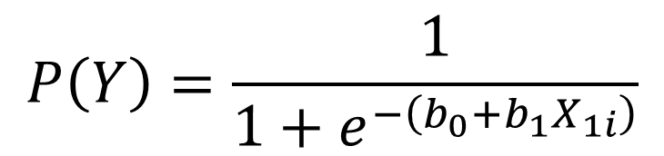
With One Predictor
Outcome
We predict the probability of the outcome occurring
b₀ and b₁
Can be thought of in much the same way as the linear model
Note the linear model equation forms part of the logistic regression equation

Slide 5
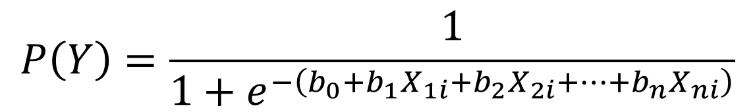
With Several Predictors
$$P\left(Y\right)=\frac{1}{1+e^{−\left(b_{0}+b_{1}X_{1i}+b_{2}X_{2i}+⋯+b_{n}X_{ni}\right)}}$$
Outcome
We still predict the probability of the outcome occurring
Differences
Note the linear model equation forms part of the logistic regression equation
This part of the equation expands to accommodate additional predictors

Slide 6
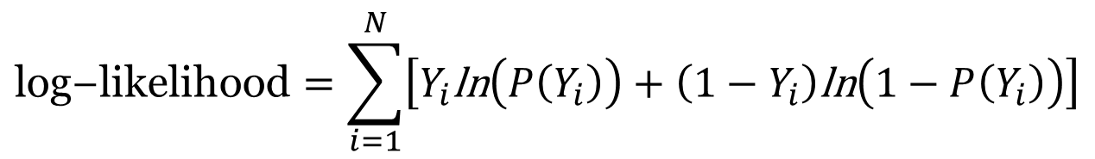
The log-likelihood
$$\text{log}\text{−}\text{likelihood}=\sum_{i=1}^{N}{\left[Y_{i}\text{ln}\left(P\left(Y_{i}\right)\right)+\left(1−Y_{i}\right)\text{ln}\left(1−P\left(Y_{i}\right)\right)\right]}$$
The Log-likelihood statistic
Analogous to the residual sum of squares in the linear model
It is an indicator of how much unexplained information there is after the model has been fitted.
Large values indicate poorly fitting statistical models.

Slide 7
The Deviance Statistic
The deviance is very closely related to the log-likelihood: it’s given by
Deviance = −2LL
It’s possible to calculate a log-likelihood or deviance for different models and to compare these models by looking at the difference between their deviances.

Slide 8
R2
This R-statistic
is the partial correlation between the outcome variable and each of the predictor variables.
It can vary between −1 and 1.
The R-statistic is given by:
Or:

Slide 9
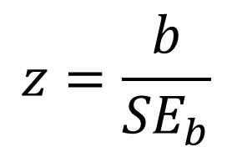
The Wald Statistic
Similar to t-statistic in the linear model
Tests the null hypothesis that b = 0
Is biased when b is large.
Better to look at likelihood-ratio statistics.
$$z=\frac{b}{{SE}_{b}}$$

Slide 10
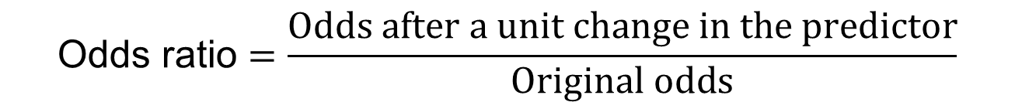
The Odds Ratio – exp(B)
Indicates the change in odds resulting from a unit change in the predictor.
OR > 1: Predictor ↑, Probability of outcome occurring ↑.
OR < 1: Predictor ↑, Probability of outcome occurring ↓.

Slide 11
Things that can go wrong
Assumptions from Linear Regression:
Linearity
Independence of Errors
Multicollinearity
Unique Problems
Incomplete Information
Complete Separation
Overdispersion

